Slide 1



Telco Customer Churn Analysis
An analysis of customer data from a telecommunications company to understand the key drivers of customer churn.
Mazen Hamada Badr

Slide 2
Project Overview
Objective:
To analyze customer data from a fictional telecommunications company to understand the key drivers of customer churn.
Goals:
Descriptive
What are the main characteristics of customers who churn?
Diagnostic
Why are these customers leaving?
Predictive
Who is most likely to churn in the future?
Prescriptive
What actions can be taken to reduce churn?

Slide 3
Data Preparation & Merging
Data Sources:
Six separate Excel files containing customer information were used: Demographics - Location - Services - Status - Population - Main Churn File
Process:
Loaded all six files into pandas DataFrames.
Standardized column names (e.g., 'Customer ID' to 'CustomerID') for consistency.
Merged the individual files into a single, master DataFrame of 7,043 unique customers.
Handled missing values, primarily by labeling null 'Churn Category' entries as "Stayed".

Slide 4
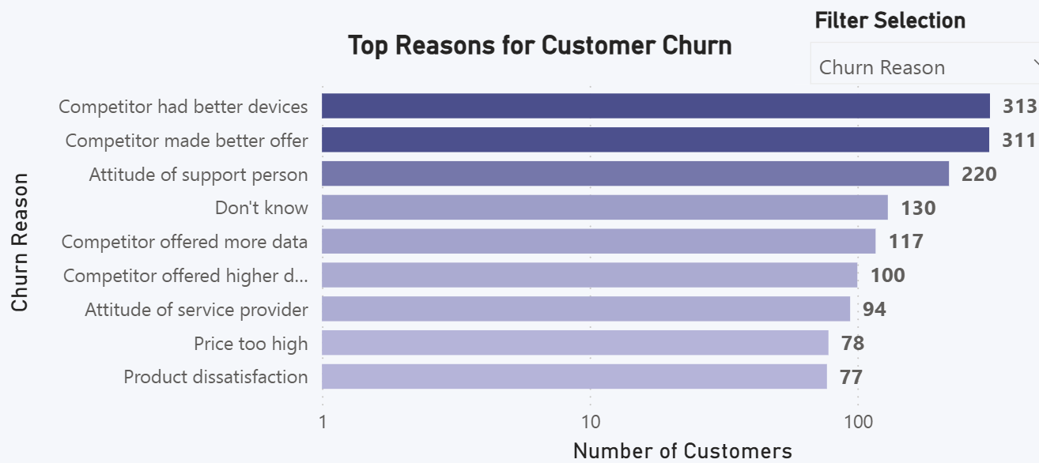
EDA – Key Churn Drivers
Key Findings:
The primary reason for churn is competitors, indicating a highly competitive market.
Dissatisfaction with the service and price are the next most significant drivers.

Slide 5
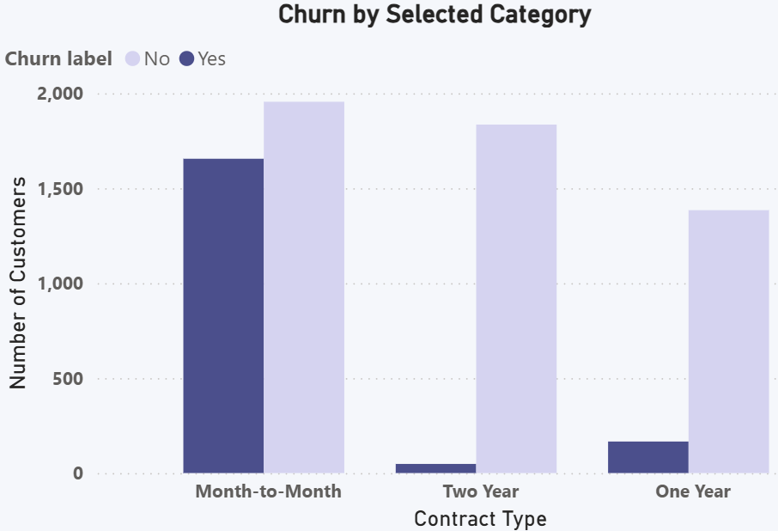
EDA - The Impact of Contracts
Key Findings:
Churn by Contract Type
Customers on Month-to-Month contracts have a dramatically higher churn rate.
One and Two-Year contracts are highly effective at retaining customers, demonstrating the power of long-term commitments.

Slide 6
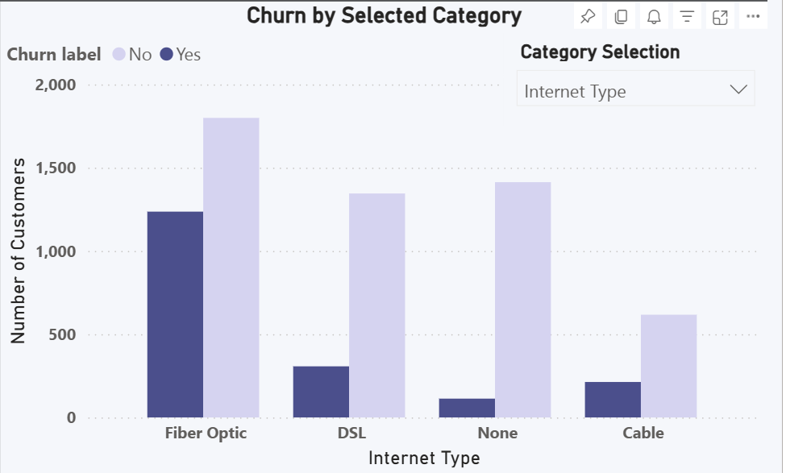

EDA – Internet Types
Key Findings:
Churn by Internet Type
Customers with Fiber Optic Internet have higher churn rate compared to other internet types.

Slide 7
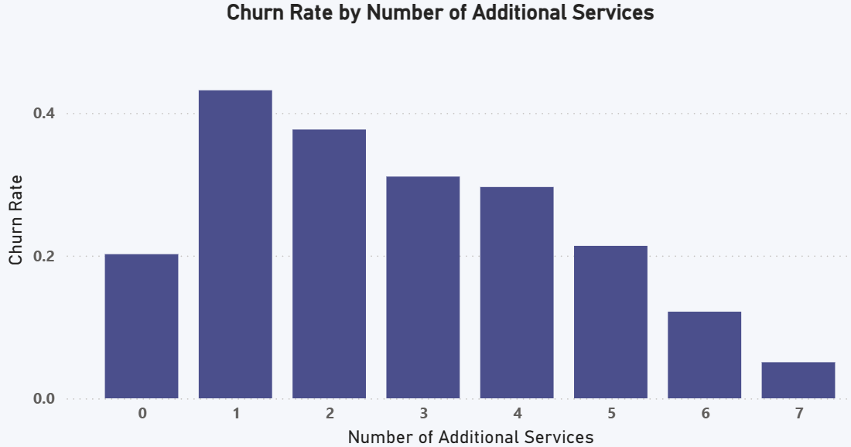
EDA – Additional Services
Key Findings:
As customers subscribe to more services, their churn rate consistently decreases.
The more invested a customer is in the ecosystem, the more loyal they become.

Slide 8
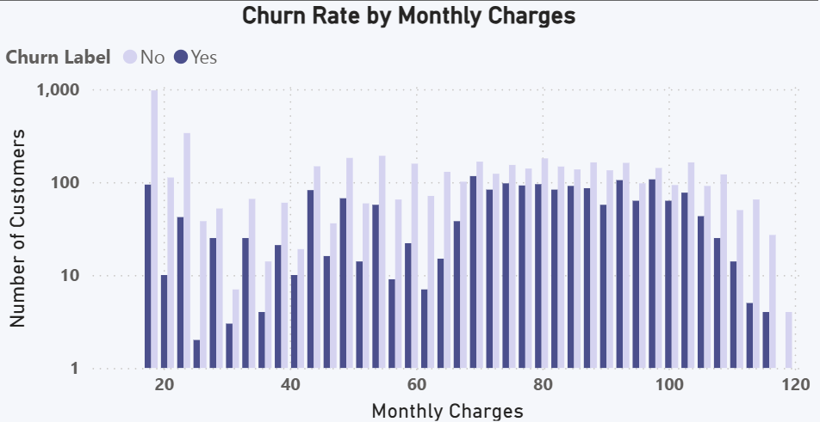
EDA – Monthly Charges
Key Findings:
Price sensitivity is a major driver of churn. Customers with more expensive plans are the most likely to leave.

Slide 9
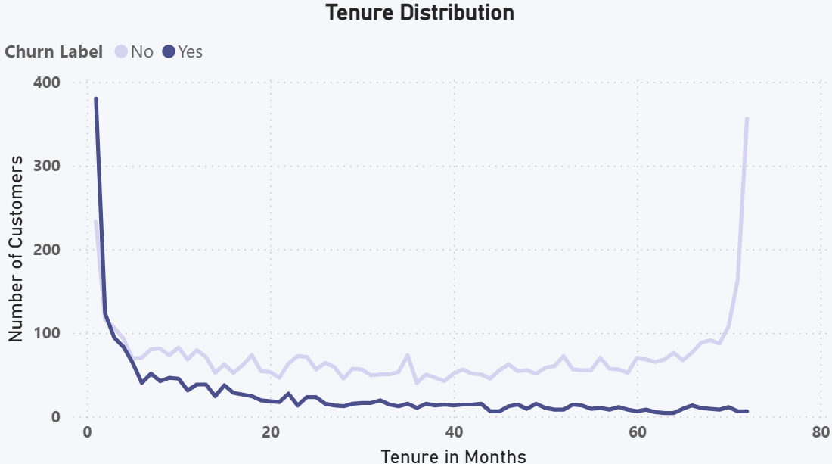
EDA - Customer Tenure & Loyalty
Key Findings:
Churn is most prevalent among new customers (those with low tenure).
Customer loyalty increases significantly over time, making the first few months of a customer's lifecycle critical for retention.

Slide 10
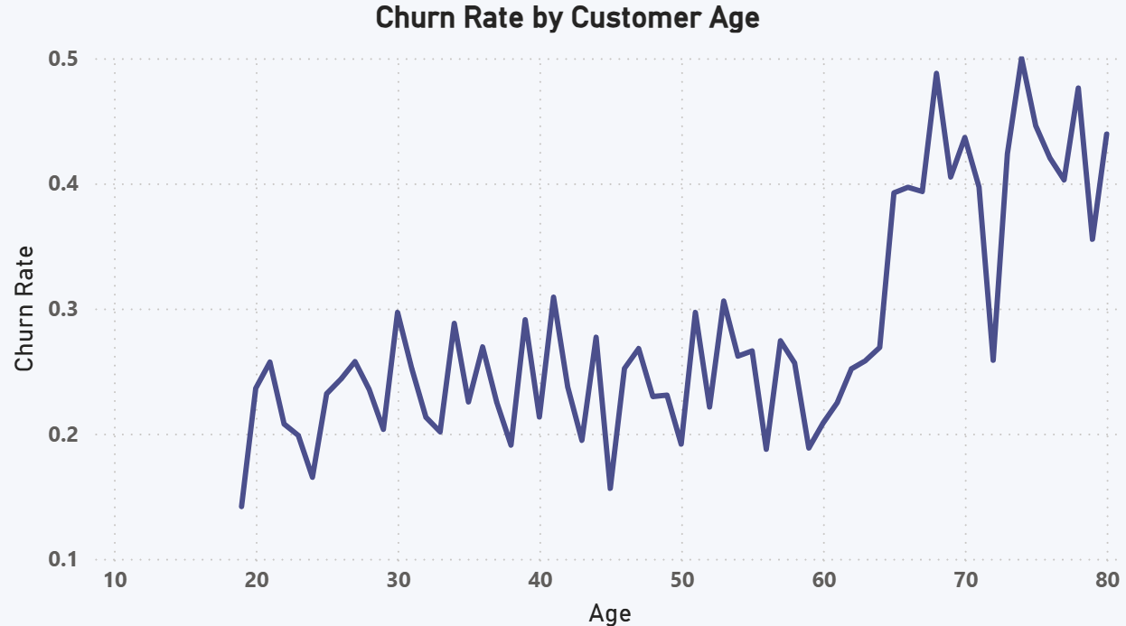
EDA – Age Distribution
Key Findings:
Senior Citizens are a High-Risk Demographic:
The churn rate spikes for customers aged 65 and older, making them a key group for retention efforts.

Slide 11
Predictive Modeling - Identifying At-Risk Customers
Objective:
To build a machine learning model that accurately predicts which customers are likely to churn.
Methodology:
Four classification models were trained and evaluated to identify the best performer.
The data was carefully cleaned to remove identifiers and features that could lead to data leakage.
Model | Accuracy
Gradient Boosting | 84.38%
Support Vector Machine | 84.10%
Logistic Regression | 83.76%
Random Forest | 83.19%
Dropped Columns:
'CustomerID', 'City', 'Zip Code', 'Latitude', 'Longitude', 'Churn Category', 'Churn Reason', 'Churn Score', 'Customer Status', 'Satisfaction Score', 'CLTV’, 'Churn Label'

Slide 12
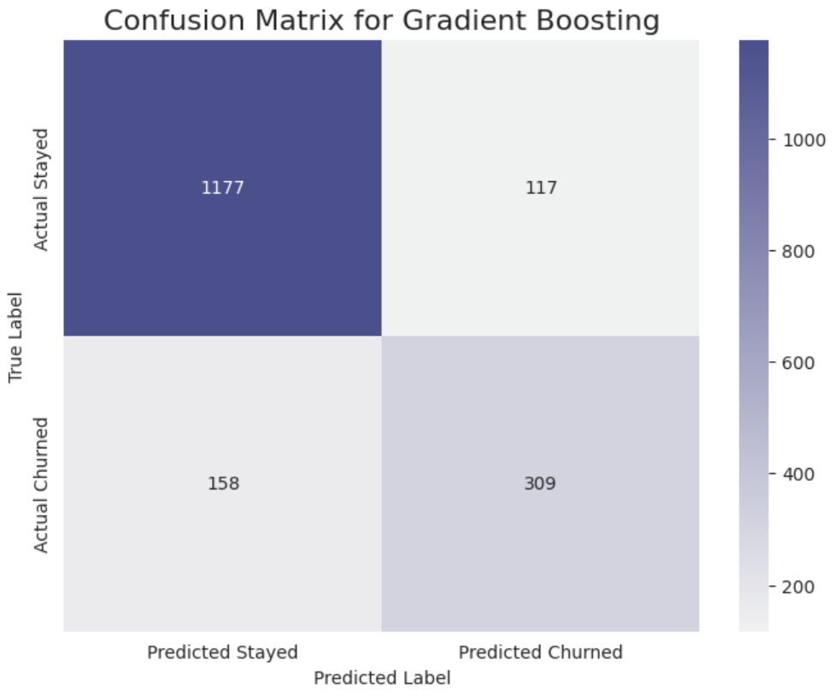
Gradient Boosting - Performance Deep Dive
Confusion Matrix Analysis:
The model correctly classified 1,486 out of 1,761 customers in the test set.
True Positives (Churn): 309 customers.
True Negatives (Stayed): 1,177 customers.
Class | Precision | Recall | F1-Score
Stayed | 0.88 | 0.91 | 0.9
Churned | 0.73 | 0.66 | 0.69

Slide 13
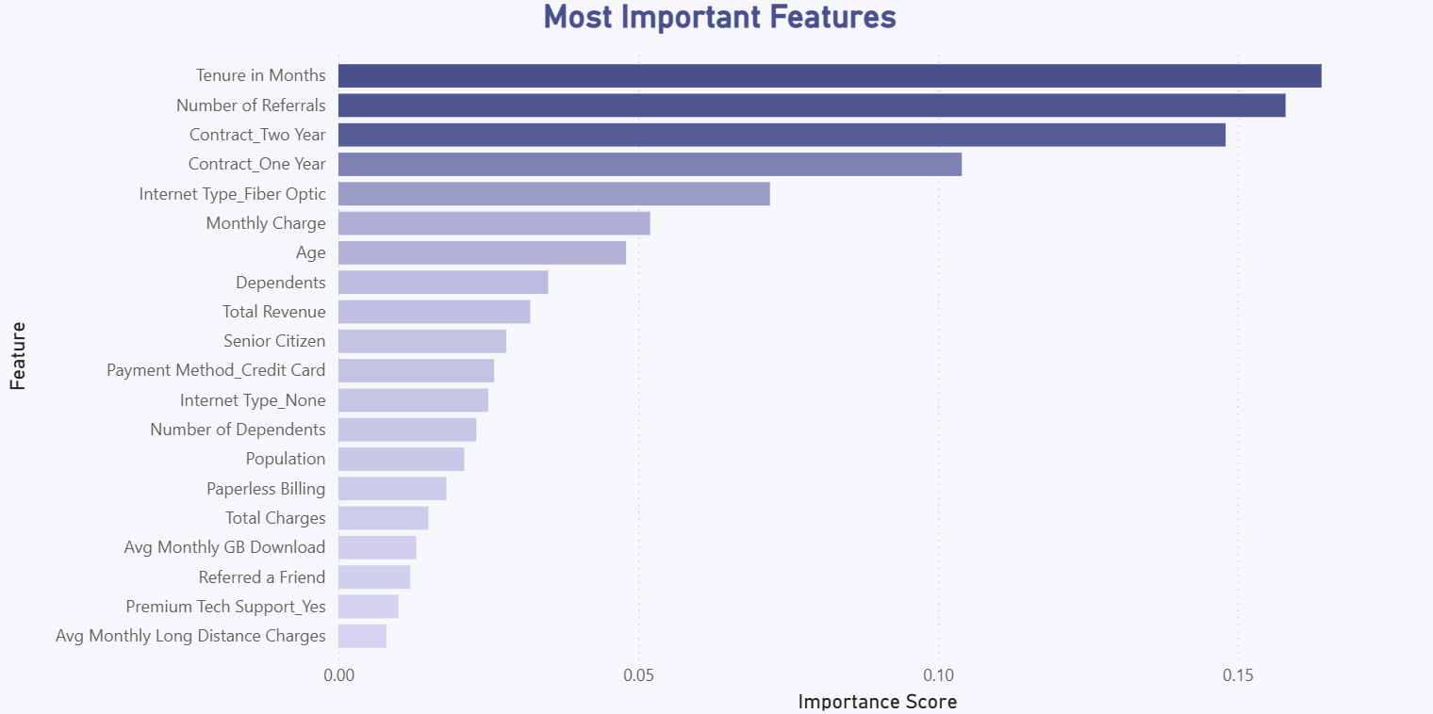
Top Predictive Features

Slide 14




Prescriptive Analysis - Actionable Recommendations
Target Month-to-Month Customers
Develop a Competitive Retention Strategy
Launch a Loyalty Program for New Customers
Improve Onboarding and Support
Proactively offer incentives for them to switch to one or two-year contracts to increase loyalty.
Empower retention teams to match competitor offers for high-value, at-risk customers (as identified by our model).
Reward customers for milestones in their first year to guide them past the high-risk early stages.
Address service dissatisfaction by investing in support training and creating a structured onboarding process for new clients.
By implementing these recommendations, the company can reduce churn and retain more valuable customers.

Slide 15


Conclusion & Next Steps
Churn is driven by competitive pressures on price-sensitive customers
Continuously monitor churn rates
Continuously monitor churn rates to measure the effectiveness of the retention initiatives.
Customer churn is primarily driven by competitive pressures on price-sensitive customers with flexible, short-term contracts.
Implement recommended retention strategies
Regularly retrain the predictive model
Regularly retrain the predictive model with new customer data to maintain its accuracy in identifying at-risk customers.
Implement the recommended retention strategies to address the key drivers of churn.

Slide 16
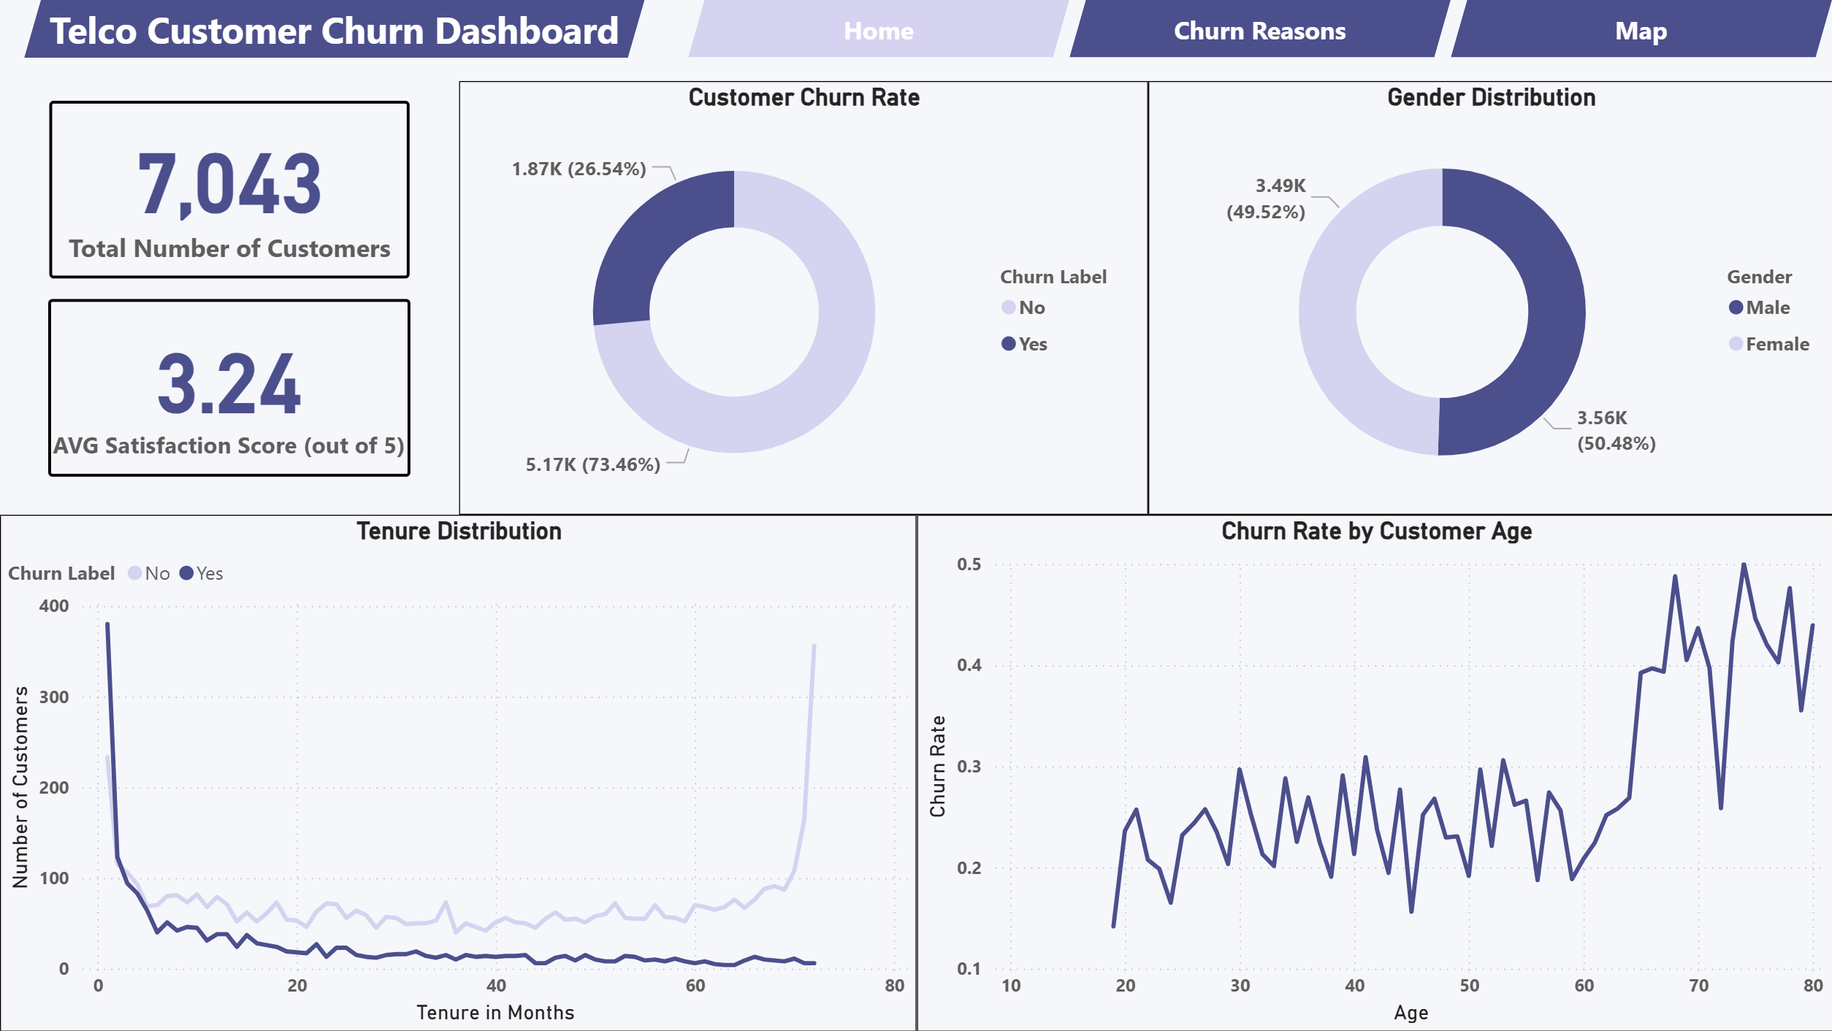
Power Bi Dashboard

Slide 17
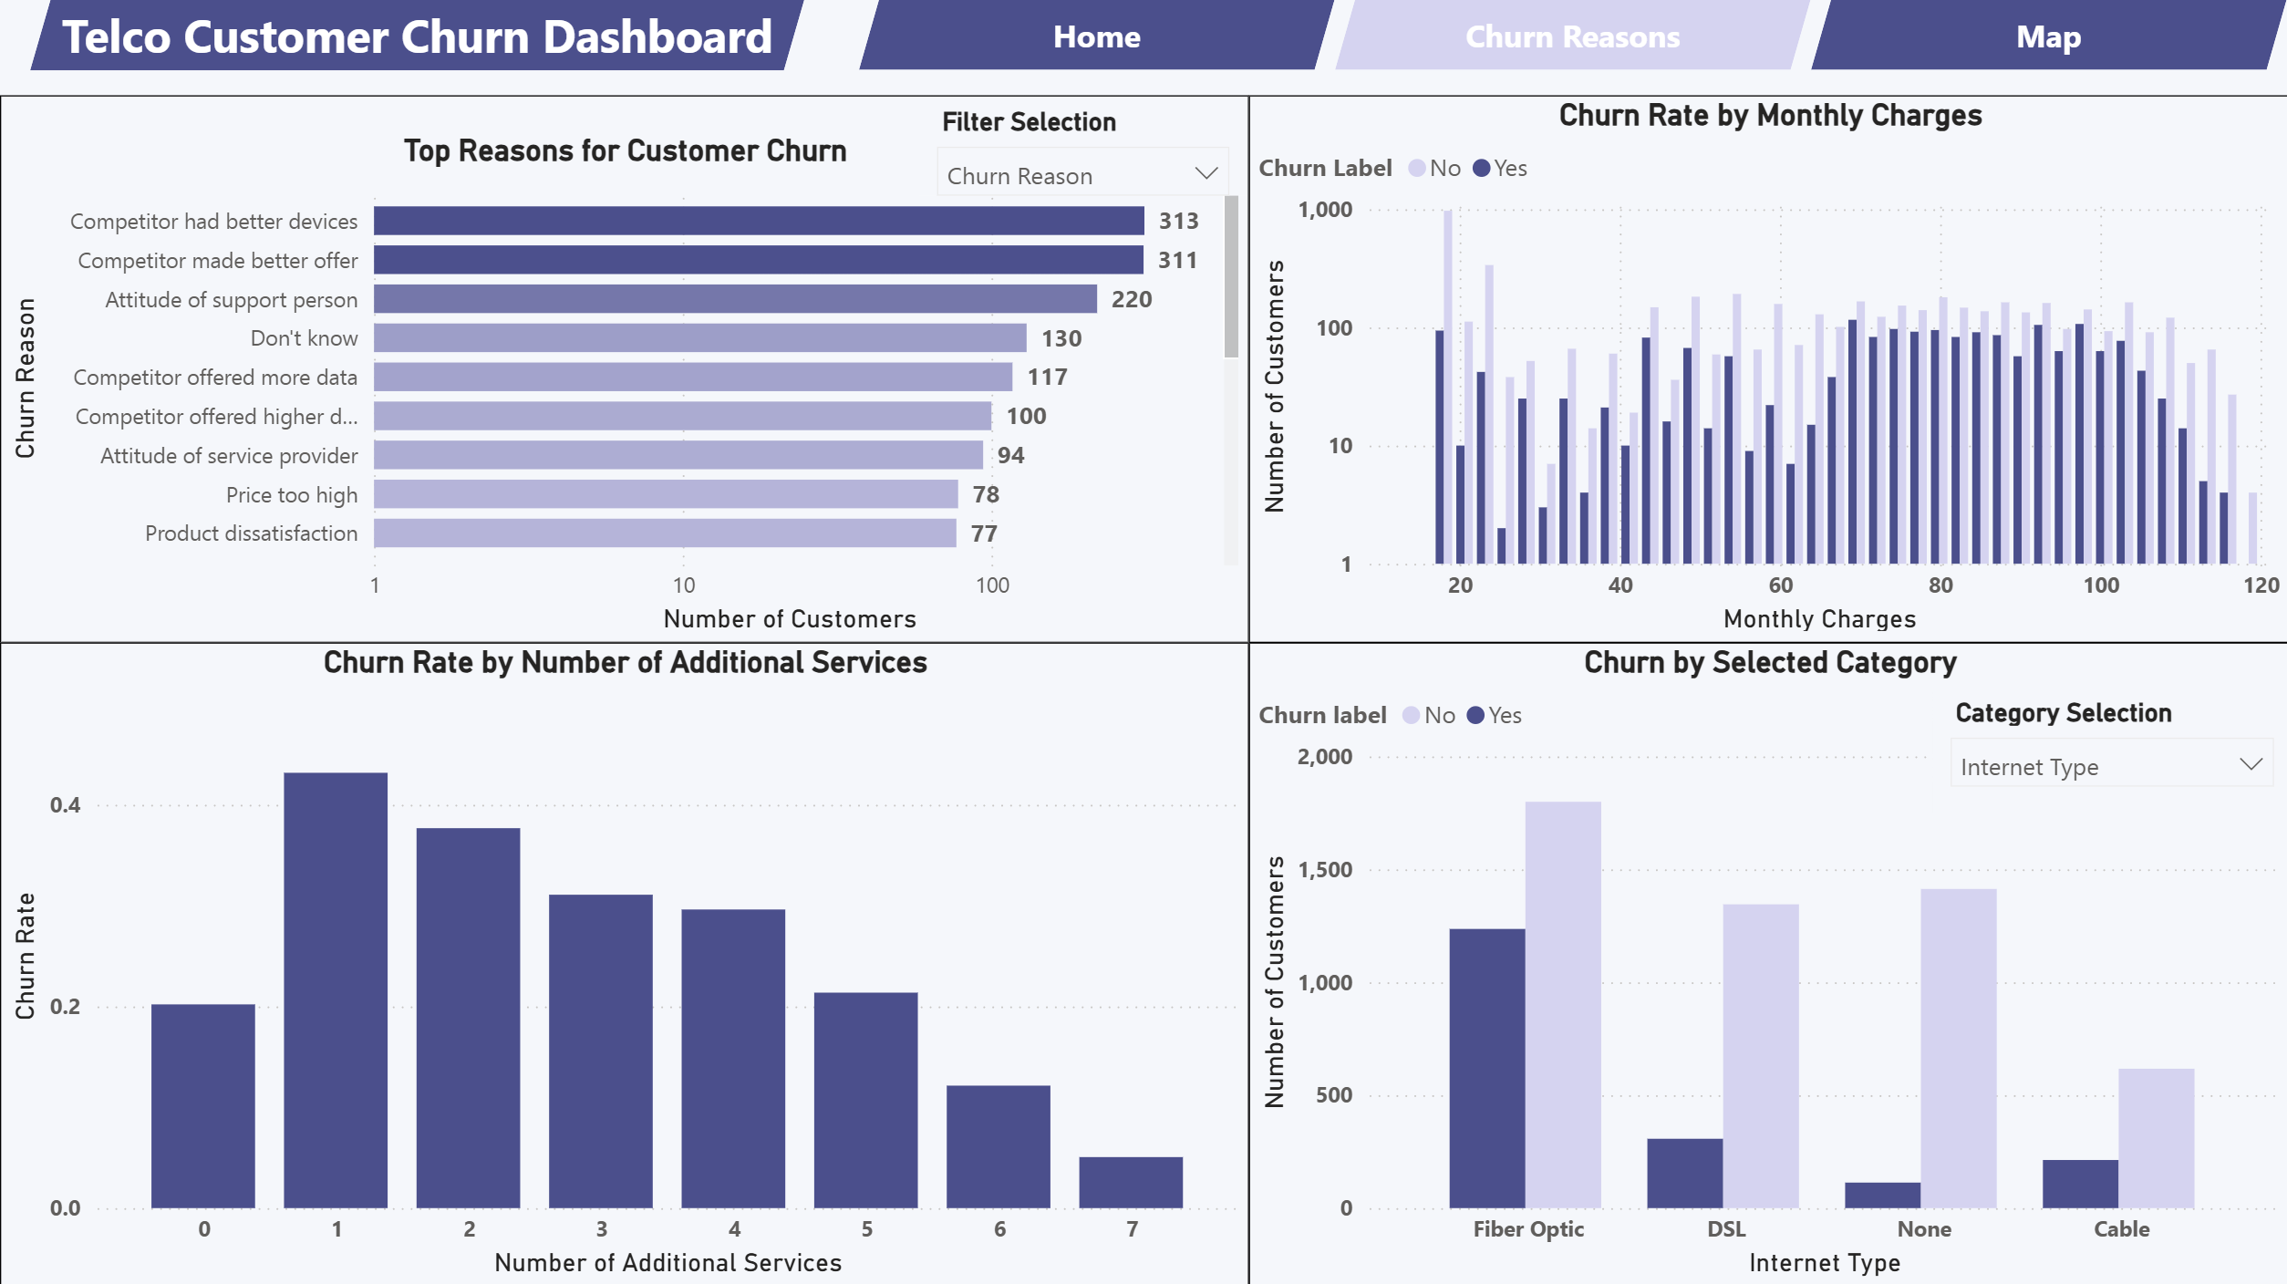
Power Bi Dashboard

Slide 18
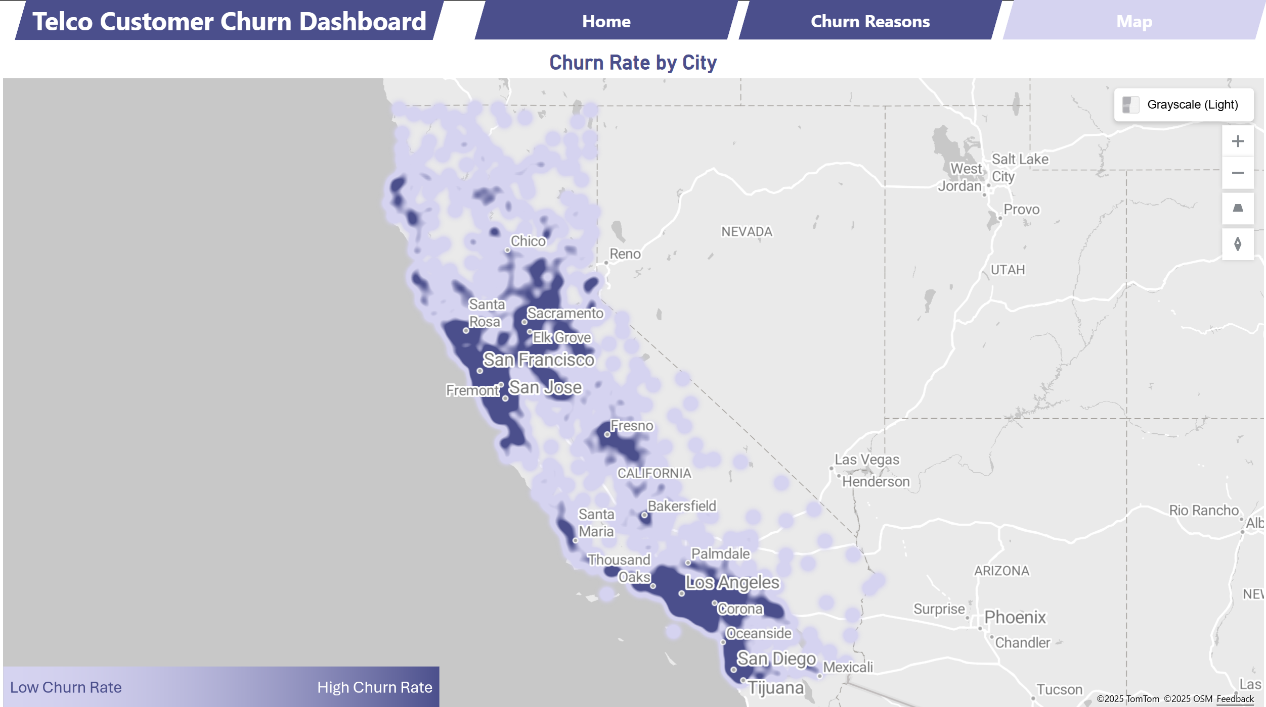
Power Bi Dashboard

Slide 19



Thank You…
GitHub Repo
Colab Notebook
Power BI Dashboard

